Slide 1
Nano Processor Design and Implementation
Group 20
Senadheera S.D.A.P. - 240604V
Sangadith K.G.D.N - 240593H
Shanujah S. - 240618R
Saranyu M. - 240295L

Slide 2
Project Objective
Design and implement a 4-bit NanoProcessor in VHDL capable of executing an 8-instruction ISA, then verify it on the Basys 3 FPGA development board.
Extend functionality with bitwise operations (AND/OR), 4-bit multiplication, and comparison.

Slide 3
Instruction Set Architecture
Basic design :
Instruction | Description | Instruction
MOVI R, d | Load immediate d into R | 10 RRR 000 dddd
ADD Ra, Rb | Ra = Ra + Rb | 00 RaRaRa RbRbRb 0000
NEG R | R = -R | 01 RRR 0000000
JZR R, d | Jump to d if R == 0 | 11 RRR 0000 ddd

Slide 4
Instruction Set Architecture
Extended design :
Instruction | Description | Instruction
MOVI R, d | Move immediate value d to register R | 0110 RRRR 000 dddd
ADD Ra, Rb | Ra = Ra + Rb | 0000 RaRaRa RbRbRb 0000
SUB Ra, Rb | Ra ← Ra − Rb | 0001 RaRaRa RbRbRb 0000
NEG R | R = -R | 0010 RRR 000 0000
AND Ra, Rb | Ra ← Ra & Rb | 0100 RaRaRa RbRbRb 0010
OR Ra, Rb | Ra ← Ra | Rb | 0101 RaRaRa RbRbRb 0000
MUL Ra, Rb | Ra ← Ra × Rb | 0011 RaRaRa RbRbRb 0101

Slide 5
Instruction Set Architecture
Extended design :
Instruction | Description | Instruction
CMP Ra, Rb | Compare Ra and Rb, set flags | 1000 RaRaRa RbRbRb 0111 1001 RaRaRa RbRbRb 0111 1010 RaRaRa RbRbRb 0111
JZR R, d | Jump if R == 0 | 0111 RRR 0000 ddd

Slide 6
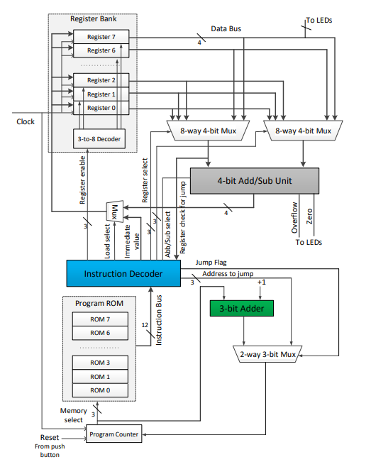
System Architecture

Slide 7
System Components

Slide 8
System Components
1. Clock System
A Slow Clock Divider reduces the 100 MHz board clock to ~1 Hz.
Enables step-by-step execution for debugging and visualization.
2. Program Flow Unit (Fetch Stage)
Program Counter (PC) holds the current instruction address.
PC Adder increments PC (PC + 1).
Address Selector (MUX) chooses:
Sequential execution (PC + 1), or
Jump address (for control flow instructions)
Program ROM stores and outputs the 12-bit instruction.
3. Instruction Decode Unit
Instruction Decoder splits the instruction into:
Register addresses (Rs, Rt, Rd)
Immediate value
ALU operation control
Jump control signals
Load selection (ALU vs Immediate)

Slide 9
System Components
4. Register Bank (Storage Unit)
Contains 8 × 4-bit registers (R0–R7)
R0 is hardwired to 0
Supports:
Read of two operands (A & B)
Write-back of results
5. Operand Selection (Data Routing)
Two 8-to-1 Multiplexers
Select Register A (source operand 1)
Select Register B (source operand 2)
6. Execution Unit (ALU)
4-bit Add/Subtract Unit
Performs:
Addition (CTRL = 0)
Subtraction (CTRL = 1)
Outputs:
Result
Zero flag
Overflow flag

Slide 10
System Components
7. Write Back Unit
Load Selector MUX
Chooses between:
Immediate value (MOVI)
ALU result
Writes final data back to selected register
8. Control Flow (Jump System)
Supports conditional/unconditional jumps
Uses register value + jump enable signal
Updates PC via Address Selector
9. Output Display Unit
LED Output
R7 value displayed on LEDs
Flags:
LED14 → Zero flag
LED15 → Overflow flag
7-Segment Display
Shows R7 value in hexadecimal

Slide 11
System Components
Overall flow:
Instruction
Program Counter
Program ROM
Decoder
ALU
Registers
7-Seg display

Slide 12
Additional Features

Slide 13
Instruction Decoder (Extended)
Opcode Extraction:
Bits 13–10 are extracted as the 4-bit main opcode to determine the instruction type (ADD, SUB, NEG, MUL, AND, OR, MOVI, JZR, EQ, GT, LT).
ALU Operation Selection:
The extracted 4-bit opcode is passed directly to ALU_Op to control the ALU operation (ADD, SUB, NEG, MUL, AND, OR, comparison operations, etc.).
Register Control Signals:
Generates Register_Enable, Register_Select_A, and Register_Select_B for selecting source and destination registers during ALU execution.
Immediate Value Handling:
Bits 3–0 are extracted as a 4-bit immediate constant for the MOVI instruction when Load_Select = '0’.
Jump Logic (JZR):
Checks whether Register_Value_For_Jump = "0000".If true, Jump_Enable is activated and the jump target address is loaded from bits 2–0.

Slide 14
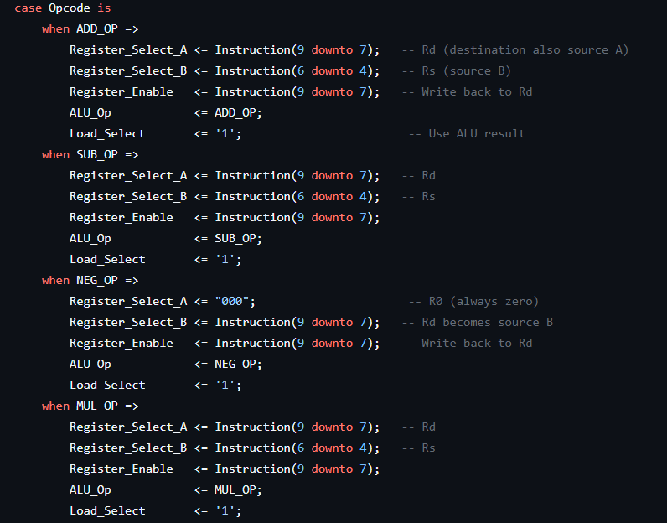
Instruction Decoder (Extended)

Slide 15
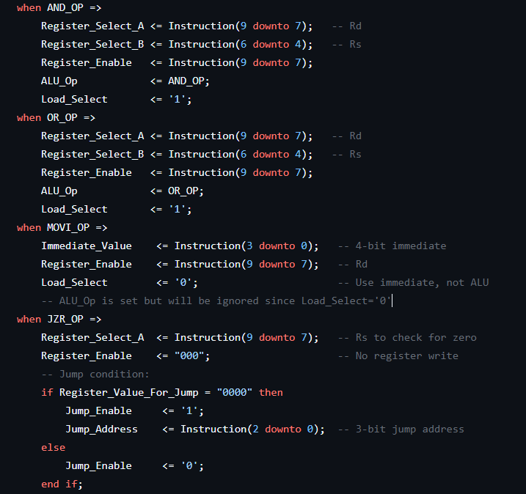
Instruction Decoder (Extended)

Slide 16
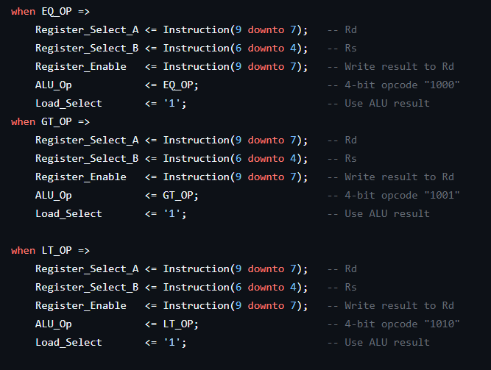
Instruction Decoder (Extended)

Slide 17
Multiplier Unit
8-bit Product Calculation:
Multiplies two 4-bit unsigned numbers (A, B) to generate an 8-bit product .
Example: 4 (0100) × 4 (0100) = 16 (00010000) → Lower 4 bits: 0000 → Upper 4 bits: 0001
Overflow Detection Support:
The ALU logic monitors the upper nibble (bits 7 to 4) of the 8-bit product.
If the upper bits are not equal to "0000", it indicates the result has exceeded the 4-bit data range.
The Overflow Flag (LED15) is automatically triggered to alert the user of the truncated result.

Slide 18


Multiplier
Overflow Detection

Slide 19
Comparator Unit
Purpose:
Compares two 4-bit unsigned numbers (Input_A, Input_B) generates comparison result flags.
Equal_Flag → Indicates both inputs are equal
LessThan_Flag → Indicates Input_A < Input_B
GreaterThan_Flag → Indicates Input_A > Input_B
How it works:
Uses unsigned arithmetic comparison from numeric_std:
If Input_A = Input_B → Equal_Flag = '1'
If Input_A < Input_B → LessThan_Flag = '1'
If Input_A > Input_B → GreaterThan_Flag = '1'
Only one flag is asserted at a time, ensuring a clear comparison result.

Slide 20
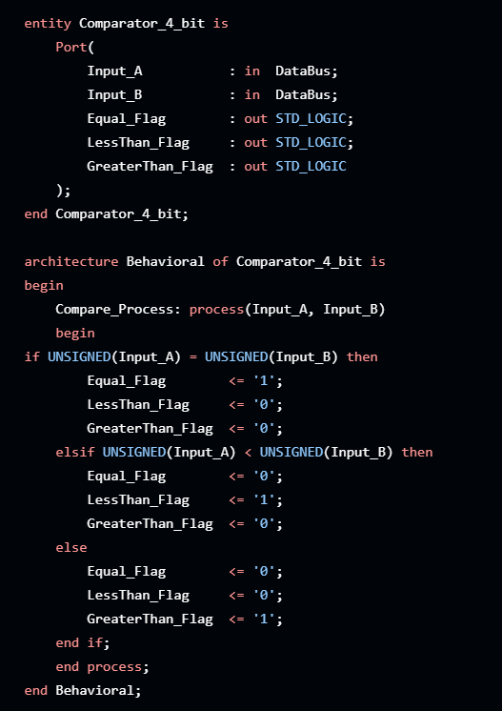
Comparator Unit

Slide 21
Bitwise Operator Unit
Performs bit-level logic operations between two 4-bit values:
AND: Result = A & B (Bitwise AND)
OR: Result = A | B (Bitwise OR)

Slide 22
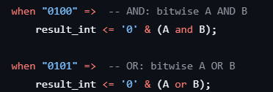
Bitwise Operator Unit

Slide 23
Extended ALU
The Extended_ALU performs multiple 4-bit arithmetic and logic operations based on the 4-bit Op control signal.
0000 → Addition (A + B)
0001 → Subtraction (A - B)
0010 → Negation (0 - B)
0011 → Multiplication (A × B)
0100 → Bitwise AND
0101 → Bitwise OR
1000 → Equal Comparison (A = B)
1001 → Greater Than Comparison (A > B)
1010 → Less Than Comparison (A < B)

Slide 24
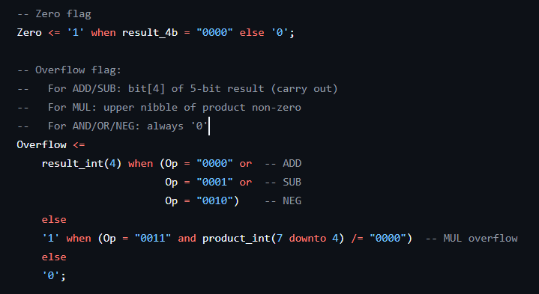
Extended ALU
Zero Detection & Overflow Detection:

Slide 25
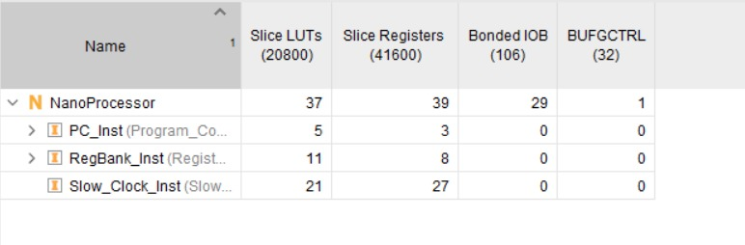
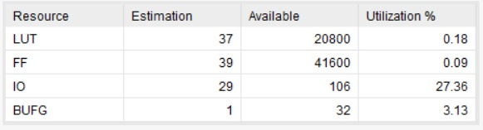
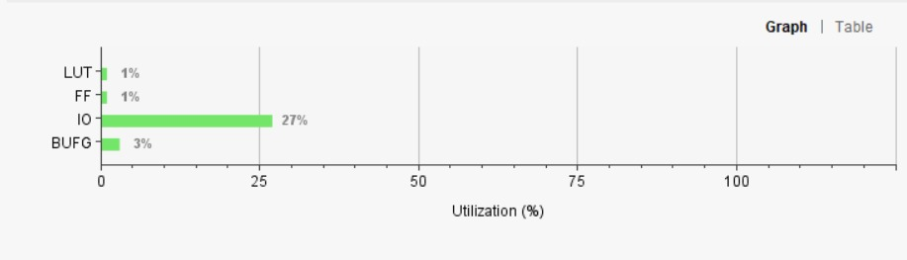
Resource Utilization (Original)

Slide 26
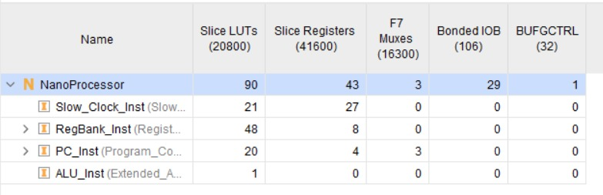
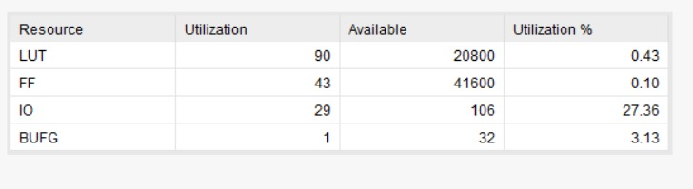
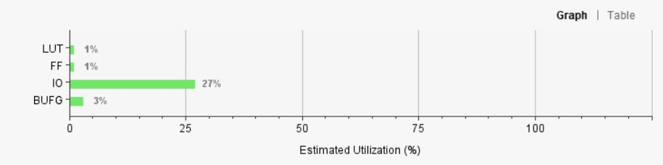
Resource Utilization (Extended)

Slide 27
Resource Optimization
Component Modularity
The same 4-bit Ripple Carry Adder (RCA) logic is used for both the Program Counter incrementer and the main ALU, reducing redundant gate logic.
Static Register R0
Register R0 is hardwired to logic '0', allowing it to be used as a constant zero source for jumps and comparison without consuming flip-flops.
Selective Flag Latching:
Comparison flags (EQ/LT/GT) only update during comparison instructions. This prevents "HALT" loops from overwriting results, ensuring display stability.
Distributed ROM
The 16x14 ROM is implemented using LUTs rather than BRAM, keeping latency to a single clock cycle.
Bus definition package
Using the BusDefinitions VHDL package improved modularity and reliability of the design. By standardizing common bus widths such as 3-bit address buses and 4-bit data buses, we reduced wiring errors, avoided bit-width mismatches, and made the system easier to maintain and expand.”

Slide 28
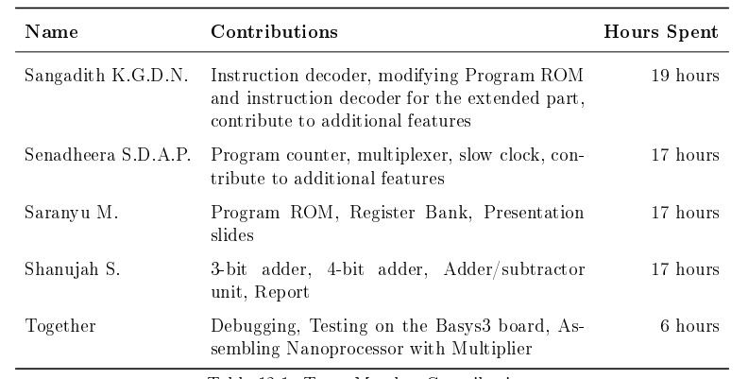
Team Contribution

Slide 29
Team Challenges
Connecting all submodules (PC, ROM, ALU, Register Bank, Decoder) correctly in the top file
Synchronizing all components with the slow clock caused timing mismatches.
7-segment display and LEDs not updating synchronously.
Hard to trace errors because design is fully modular.

Slide 30
Conclusion
Achievements:
4-bit Nanoprocessor: Successfully executes 8 instructions (Arithmetic, Logic, and Branching).
Extended Functionality: Integrated Multiplication, Comparisons (EQ, GT, LT), and Overflow detection.
Hardware Validation: Verified on BASYS 3 with real-time 7-segment display and status LED mapping.
Key Learnings:
Instruction Architecture: Designed a 14-bit instruction format to support an expanded operation set.
Mastered 4-bit arithmetic and range validation (0 to 15).
Team Collaboration: Streamlined VHDL development through modular design and collaborative hardware testing.

Slide 31
Thank You !

